Slide 1
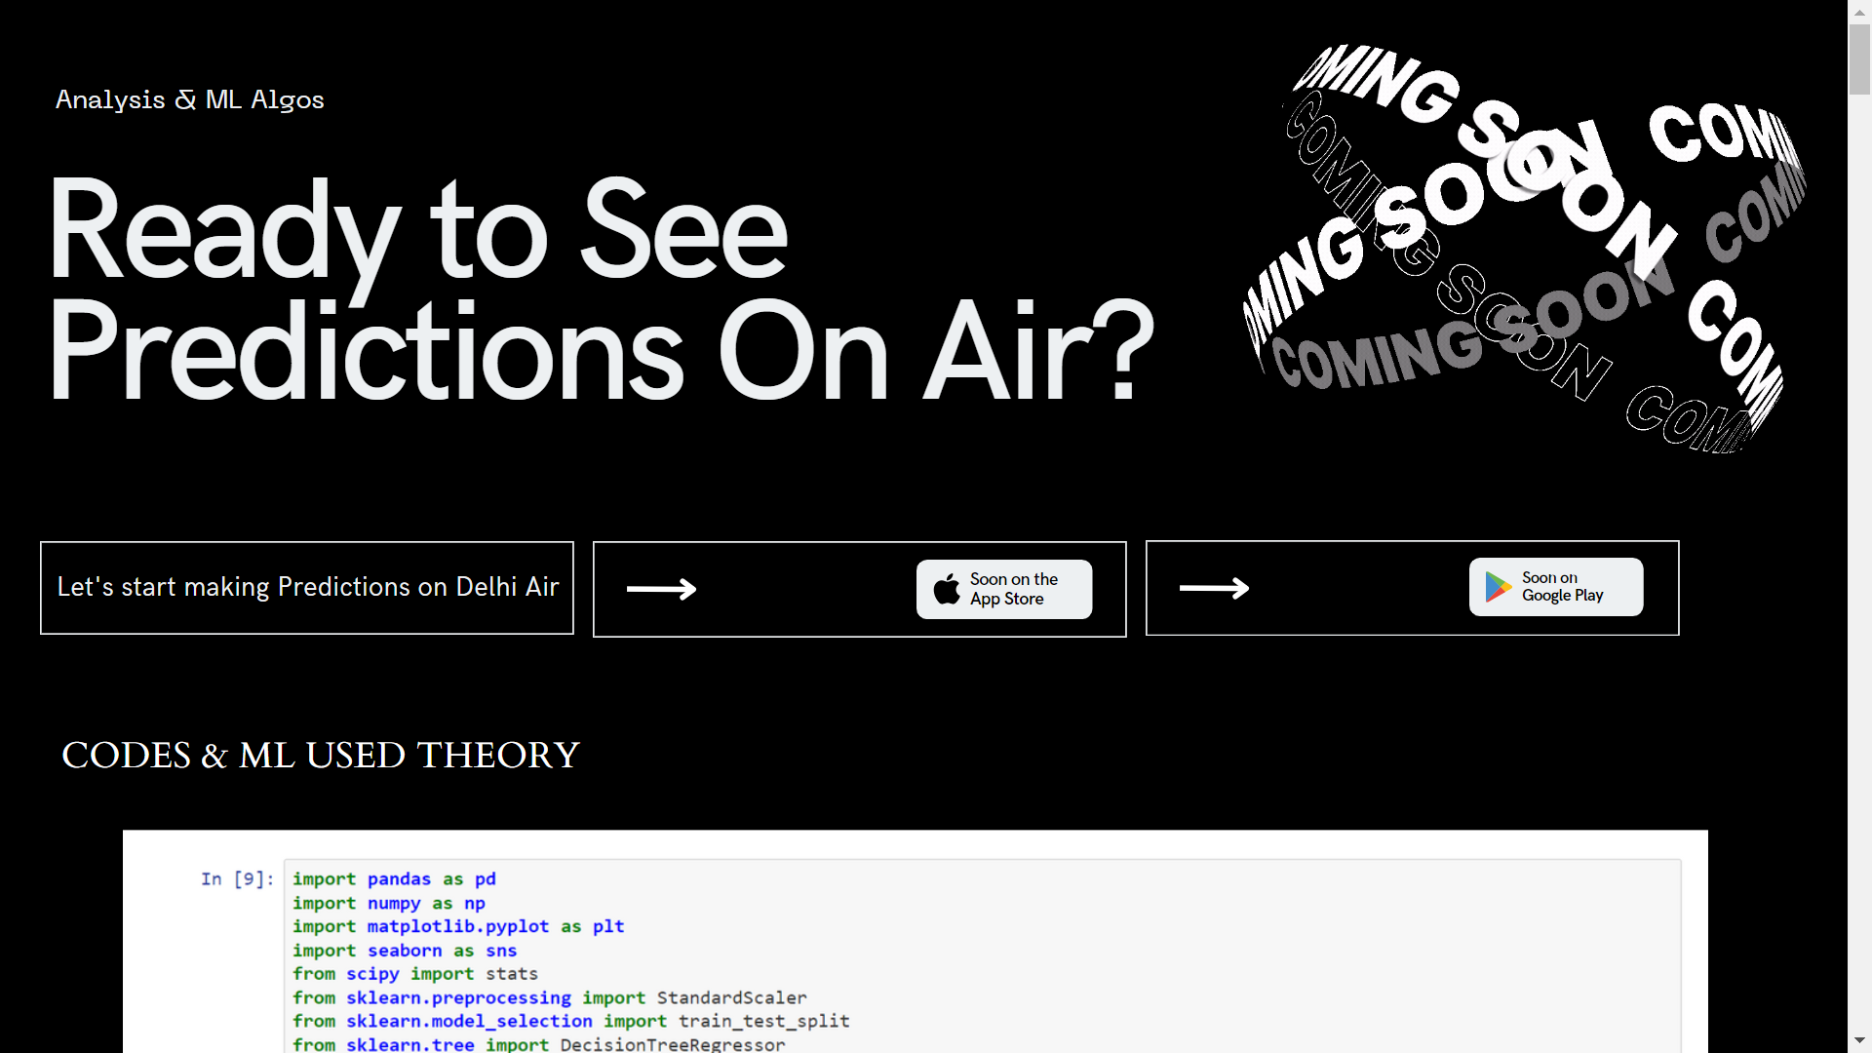




Base : Machine Learning Algorithm
Air Quality Predictions
Khushi Sihag - 01313702021
Harmandeep Singh - 030702021
www.air-quality-predict.com
@Minor Project Presentation - 2023

Slide 2







Introduction
Presentation Overview
Predicting air quality means guessing how much pollution will be in the air in the coming time. This is really important for keeping people healthy, watching the environment, and making rules about what we can and can't do. Lots of things, like car exhaust, factories, nature, and weather, all affect how clean or dirty the air will be. By figuring this out, we can take steps to keep the air as clean as possible for everyone.

Slide 3





OBJECTIVE
AIR QUALITY PREDICTIONS
The primary objective of air quality prediction is to leverage scientific models and computational techniques, often facilitated by tools like Python programming, to forecast and anticipate variations in air pollutant levels within specific regions or areas. By analyzing historical and real?time data encompassing various pollutants like particulate matter (PM2.5, PM10), ozone, nitrogen dioxide (NO2), sulfur dioxide (SO2), and carbon monoxide (CO), these predictive models aim to provide accurate and timely information about air quality.

Slide 4


Our Project
Research Question 1 ?
Main Questions
Which machine learning techniques have been used within the domain of air quality prediction?
Research Question 2 ?
Which features have the highest impact on the machine learning algorithm’s ability to accurately perform predictions?
Research Question 3 ?
How accurate are machine learning methods for predicting air quality in Trondheim?

Slide 5


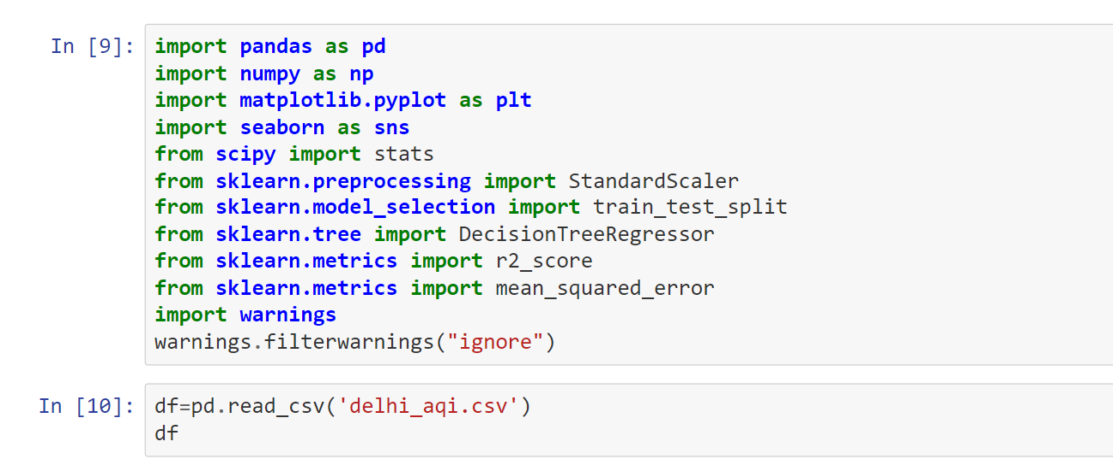

Main Libaries Used !
RQ1 relates to the structured literature review part of this thesis. Machine learning is a hot topic and frequently referred to in research within air quality prediction. State-of-the?art techniques will hold valuable knowledge which can be transferable to the experiments conducted in Trondheim

Slide 6




Pandas (import pandas as pd):
Data manipulation and analysis.
Functions to clean, transform, and explore datasets easily.
NumPy (import numpy as np):
Numerical operations and computations in Python.
Mathematical functions and arrays.
Enhancing performance and efficiency.
Matplotlib (import matplotlib.pyplot as plt):
Plotting library.
Create visualizations, including line plots, scatter plots, histograms, bar charts, etc.,
Aiding in data exploration and presentation.
Seaborn (import seaborn as sns):
Seaborn works alongside Matplotlib & offers a higher-level interface.
Creating more attractive and informative statistical graphics & Better default styles.

Slide 7

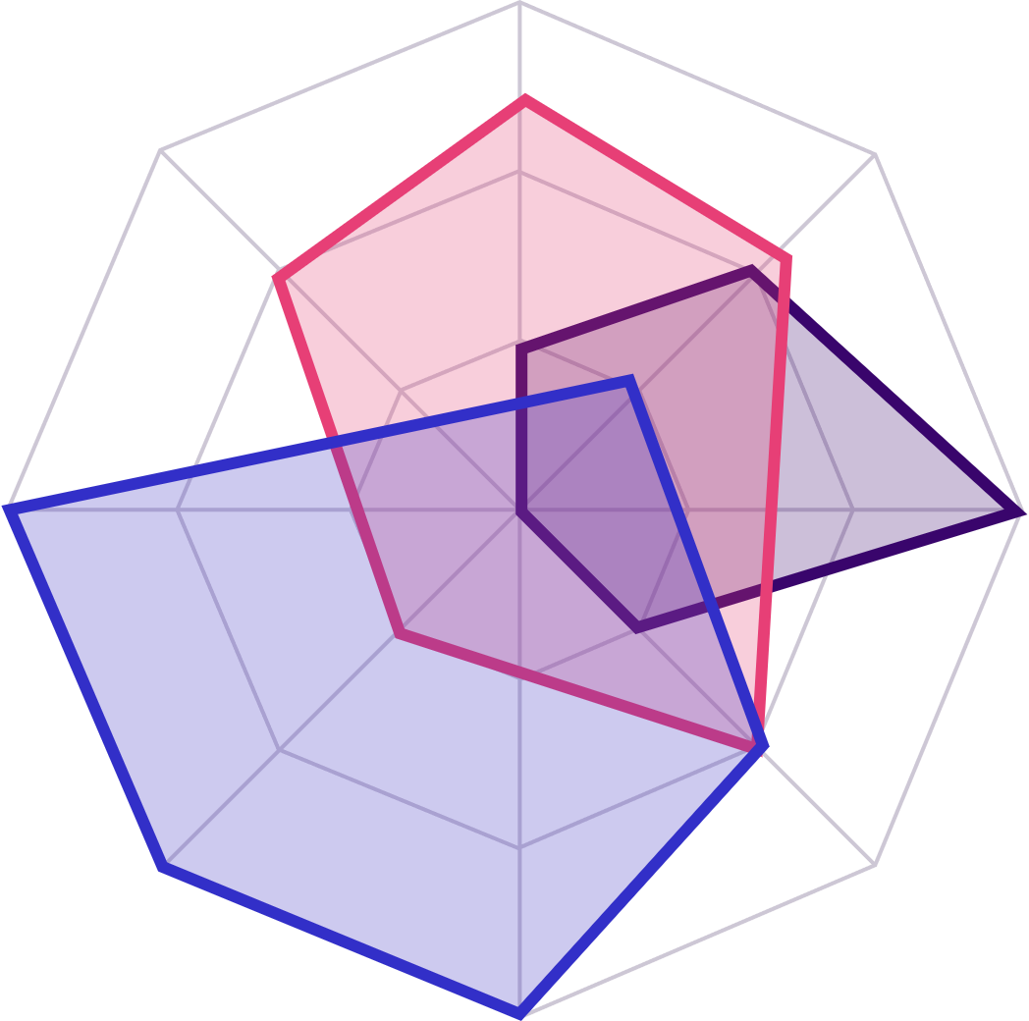

SciPy (from scipy import stats):
SciPy is built on NumPy
provides additional functionalities for scientific computing.
‘Stats’ module is used for statistical tools and tests
Useful for data analysis and hypothesis testing.
scikit-learn modules (from sklearn...):
Provide tools for - Data preprocessing (like StandardScaler),
- Model selection (train_test_split),
- Regression models (DecisionTreeRegressor), and
- Evaluation metrics (r2_score, mean_squared_error).
Warnings (import warnings):
Allows handling or suppressing warning messages ( appear in code execution). Used to manage unnecessary output or alerts during analysis.

Slide 8
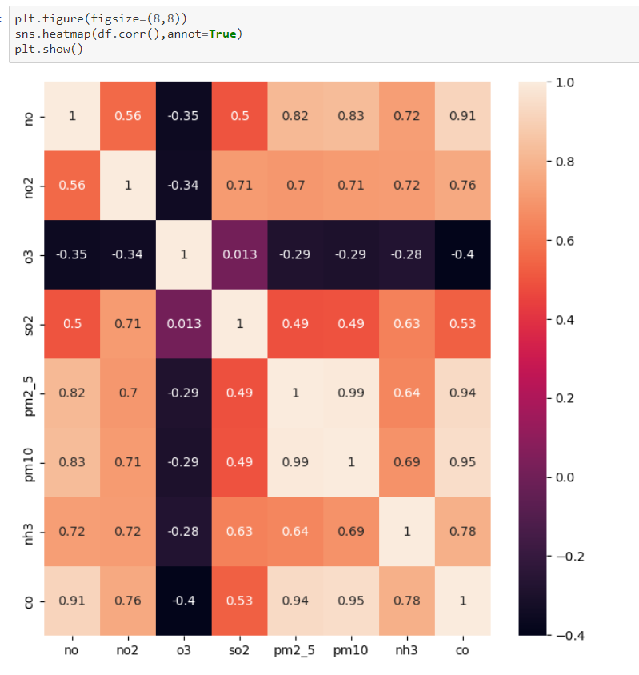
Main Libaries Used !
SEABORN :Heatmap
Function on the correlation matrix of the DataFrame df.
Visual Representation: Display how different variables in your data are related.
Color-Coded Relationships: By using colors, the heatmap makes it easier to identify which pairs of variables are positively correlated (closer to 1, usually represented by warmer colors like red) or negatively correlated (closer to -1, cooler colors like blue). A correlation near 0 suggests no strong relationship between the variables.
Quick Data Exploration : Fast and intuitive way to spot patterns and connections among variables.

Slide 9
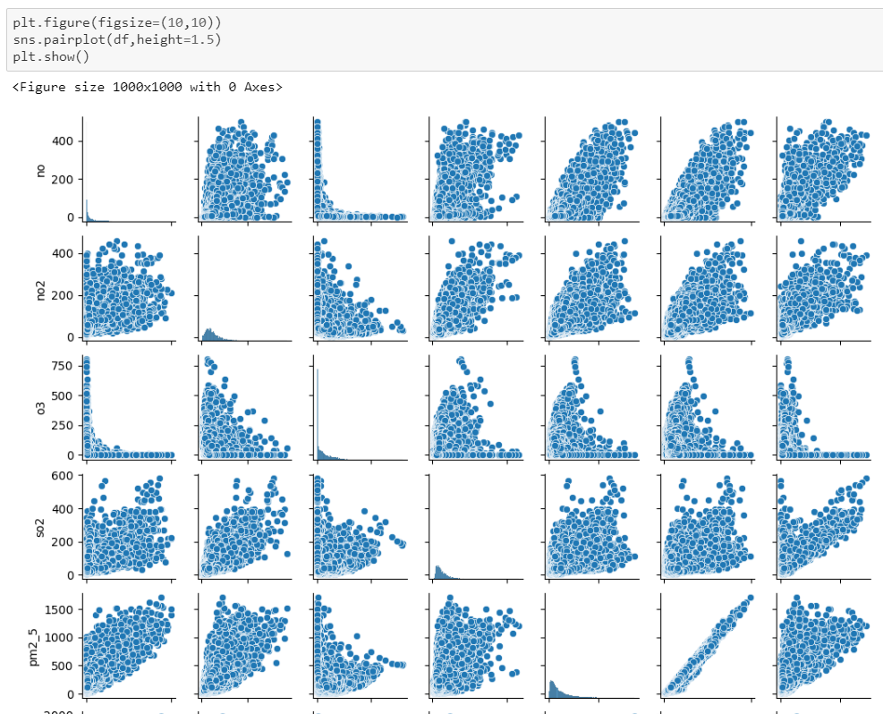
Main Libaries Used !
SEABORN : PairPlot
Quick and comprehensive examination of relationships between multiple variables in your dataset,
Visualizing Relationships : Display connections between variables (via scatterplots and histograms ).
Pattern Recognition : Identifies links or trends between variables, like pollutant correlations.
Initial Data Check : Helps understand relationships, outliers, and patterns early on.
Correlation Understanding : Shows if variables move together or not, guiding feature choices.

Slide 10
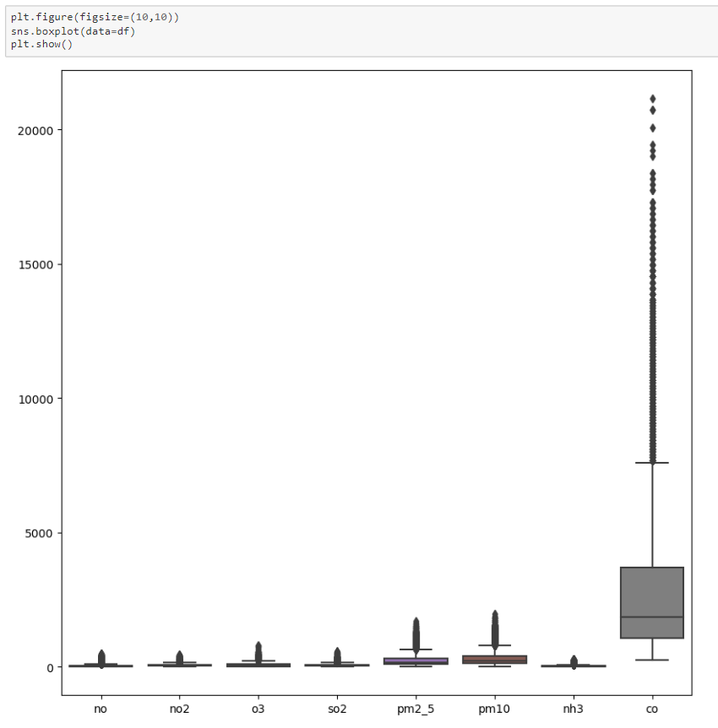
Main Libaries Used !
SEABORN : BoxPlot
Distribution of numerical data and highlights key statistical measures, such as median, quartiles, and potential outliers.
Distribution Understanding : Box represents IQR, middle line is median, and whiskers show data range (excluding outliers).
Outlier Detection: Points outside whiskers could be extreme values or outliers.
Variable Comparison: Boxplots compare distributions of multiple variables.
Skewness : Helps see if data is symmetric, skewed, or variable spread.

Slide 11
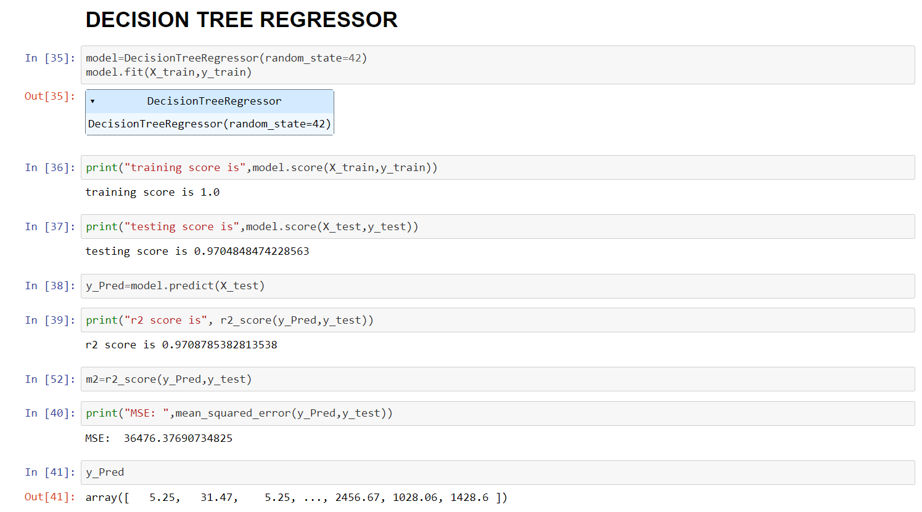

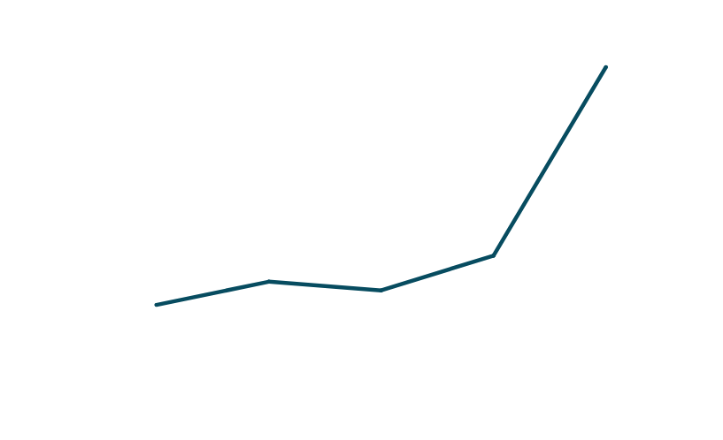
Algorithm
Decision Tree Regression
Uses a flowchart-like tree structure or is a model of decisions.
Falls under supervised learning algorithms.

Slide 12
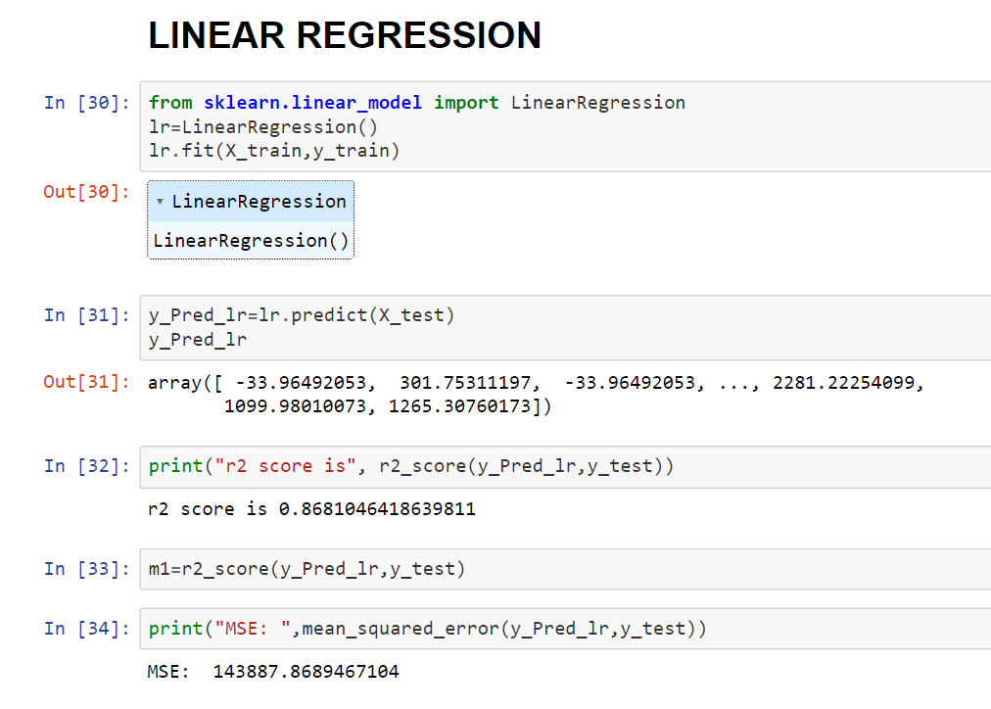

Algorithm
Linear Regression - 86%
Regression Analysis
Handling Non-linear Relationships
Feature Importance:

Slide 13











Comparison Data
Best Algorithm to choose
Linear Regression - 86%
Data issues like inaccuracies, incomplete records, or errors in meteorological data can heavily affect model performance. Outliers, missing values, and skewed distributions also distort the learned relationships. Choosing relevant features is crucial as it directly impacts the model's ability to understand air quality dynamics.
Decision Tree - 97%
The decision tree's predictability hinges on key parameters like max tree depth, min samples per leaf, and splitting criteria, shaping its complexity and structure. Proper tuning prevents overfitting or underfitting, finding a balance in depth to capture patterns without overcomplicating. Yet, tree-based binary splits at feature thresholds can cause instability or high variance if the tree goes too deep or captures noise, affecting its generalization to new data.
SVM (Support Vector Machine) - 34%
Regression Technique: SVR is used for regression tasks, predicting continuous outcomes.
Complex Relationships: Effective for nonlinear relationships between features and targets.
Kernel Trick: Utilizes a kernel function to map data into higher dimensions for better separation.
Robust to Outliers: SVR is less sensitive to outliers due to the use of a margin of tolerance.
KNN (K-Nearest Neighbors) - 98%
Prediction by Similarity: KNN predicts by comparing with the 'K' most similar data points.
No Assumptions: Doesn't make assumptions about data distribution, works well with complex data.
Classification & Regression: Can be used for both classification and regression tasks.
Impact of 'K': The choice of 'K' (number of neighbors) affects the model's flexibility and bias-variance tradeoff.

Slide 14
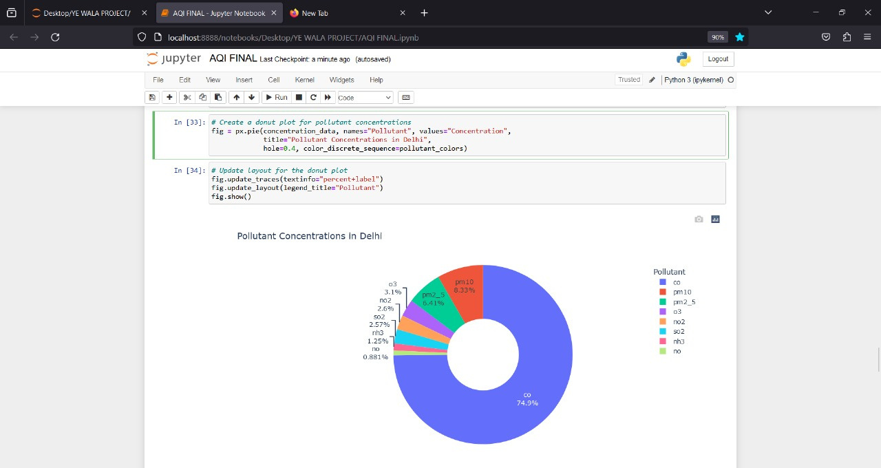
CREATING PIE CHART
OF GAES

Slide 15



Conclusion
Advanced Sensors: Portable, low-cost sensors enable widespread real-time air quality monitoring via IoT networks.
ML & AI: Algorithms process diverse data (satellite, weather, emissions) for more accurate predictions.
Big Data Integration: Incorporating meteorological, traffic, socio-economic data unveils complex patterns.
Enhanced Resolution: Higher resolution models provide localized insights crucial for urban areas.
Non-linearity Handling: Models need to capture complex relationships in air quality data for accuracy.

Slide 16



FUTURE SCOPE
Resolution Enhancement: Future models aim for better localized predictions and real-time updates.
Real-time Monitoring: Sensors and data processing enable immediate action for mitigating poor air quality.
Health Impact Assessment: Models to not just predict pollutants but assess health risks for proactive measures.
Emission Control: Predictive models aid in emission control and proactive maintenance.

Slide 17

AIR QUALITY ﻿PREDICTIONS - Minor Project’23
Thank You
For Your Attention
www.air-quality-predict.com
@Minor Project Presentation - 2023

